Slide 1
Free Adobe- Basic Instructions to Sign PDF Documents
Genesee Community College
January 2021
Includes text and images from https://get.adobe.com and https://helpx.adobe.com/reader/using/sign-pdfs.html

Slide 2
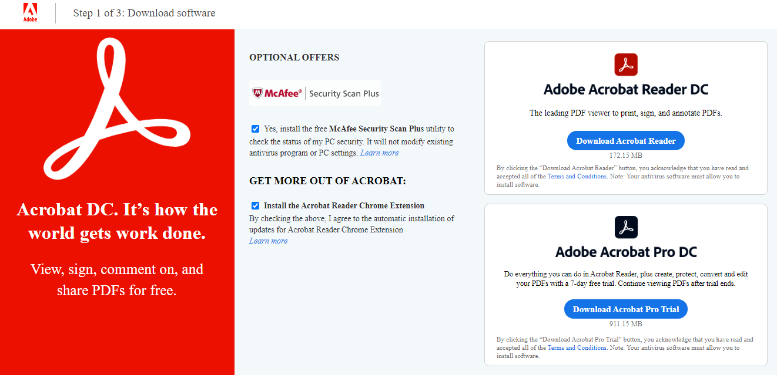
Download the Free Adobe Acrobat Reader DC
Open a web browser and navigate to https://get.adobe.com/reader
Click the 2 ✓ under Optional Offers to deselect these options
Click the blue Download Acrobat Reader button

Slide 3
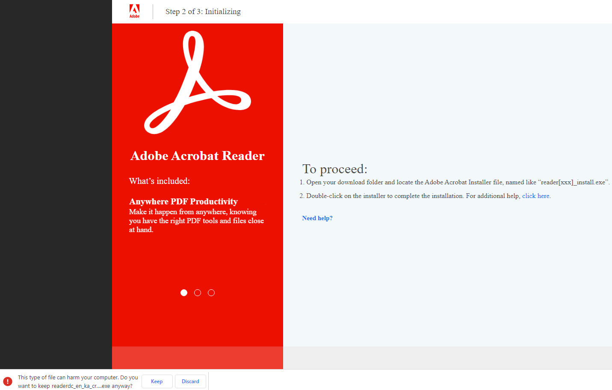
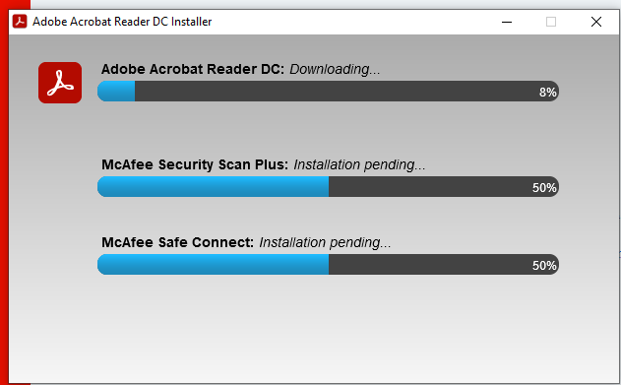
Initialize and Install the Reader
Click the Keep button in the lower left
Click the carat, then click Open
The Installer window will open and install the Reader

Slide 4
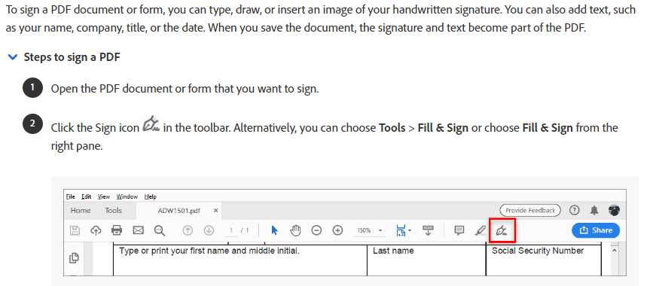
Open the Sign Tool

Slide 5
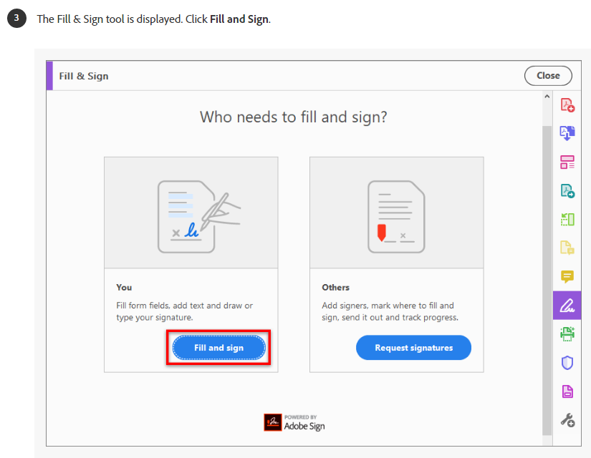
Fill & Sign
X

Slide 6
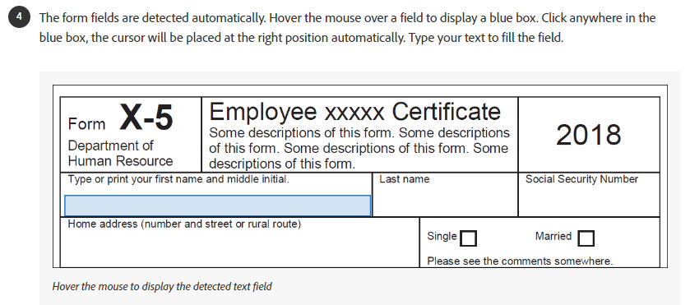
Add Your Name to the Form Fields

Slide 7
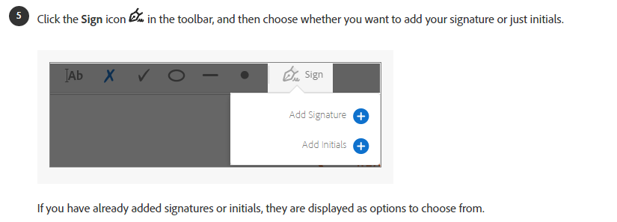
Add Signature

Slide 8
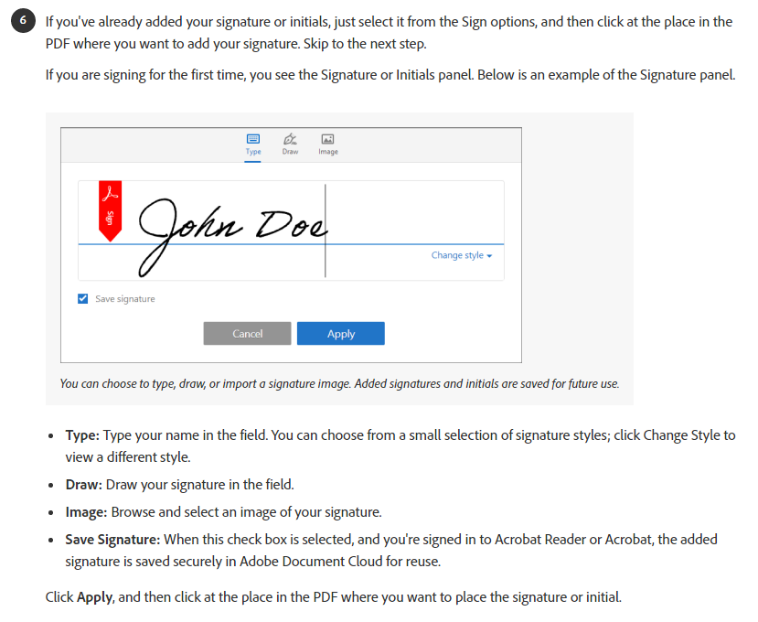
Add Existing or New Signature

Slide 9
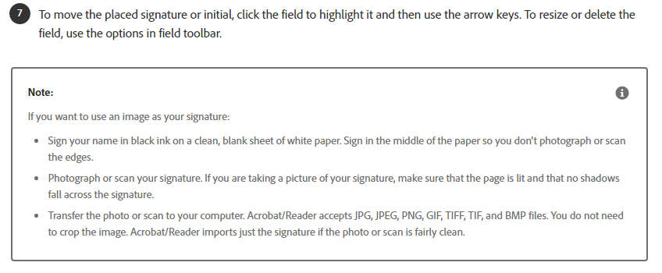
Using an Image as Your Signature (optional)

